Slide 1
ELECTION BOOTH SYSTEM
Presented By:
Ketki Jain (CS21039)
Nilay Manekar (CS21051)
Divya Shivhare (CS21061)

Slide 2
Election booth system
Problem Statement
In the context of our SEQA Lab project, the challenge is to design and implement an efficient and secure election booth system for college-level elections. The current election process in our college lacks technological sophistication, transparency, and accessibility, leading to inefficiencies and potential security risks. To address these issues, we aim to develop an Election Booth System (EBS) that will streamline the entire voting process, ensuring fairness, transparency, and security.

Slide 3
OBJECTIVES
Ensuring Fairness and Transparency
Real-time Results: Enable real-time vote counting and transparent display of election results, fostering trust in the electoral process.
Participation and Engagement
Increased Voter Participation: Encourage more students to participate in elections by offering a convenient and user-friendly voting experience.
Compliance and Data Protection
Data Privacy: Safeguard voter information and election data by adhering to data privacy regulations and best practices.
Streamlined Administrative Processes
Data Management: Centralize and streamline voter information and election data for easier management and analysis

Slide 4
REQUIREMENTS
Functional Requirements
Non-Functional Requirements
1
Voter Login
Scalability
2
Secure Authentication
Accessibility
3
Electronic Voting
Reliability
4
Real-time Results
Data Privacy
5
Automatic election scheduling
Usability

Slide 5
Working Of Different Modules
1
2
3
Voter Secure Authentication
Super User Operability
Real-time Result Display
Voters enter their credentials and receive a one-time password (OTP) for authentication.
Once authenticated, voters can access the voting interface to select their preferred candidates.
Access to a comprehensive dashboard with administrative privileges.
Control over system settings, security parameters, and configurations.
Ability to manage voter access controls, and user permissions.
This module provides live updates of ongoing voting and displays real-time results.
Constantly updates and displays the current vote counts for each candidate or ballot measure.

Slide 6
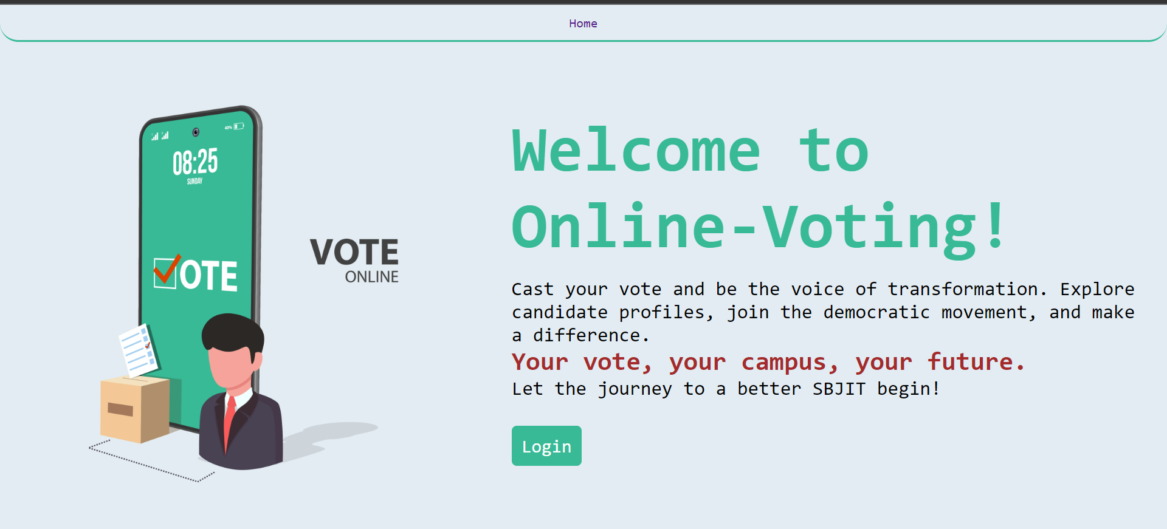
Snapshots

Slide 7
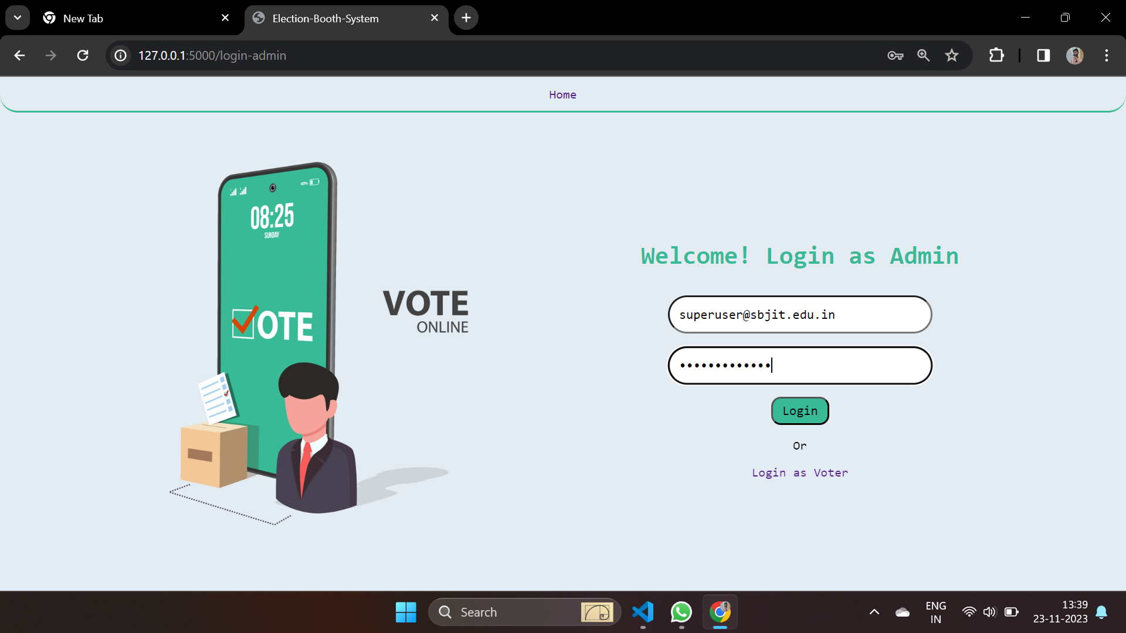

Slide 8
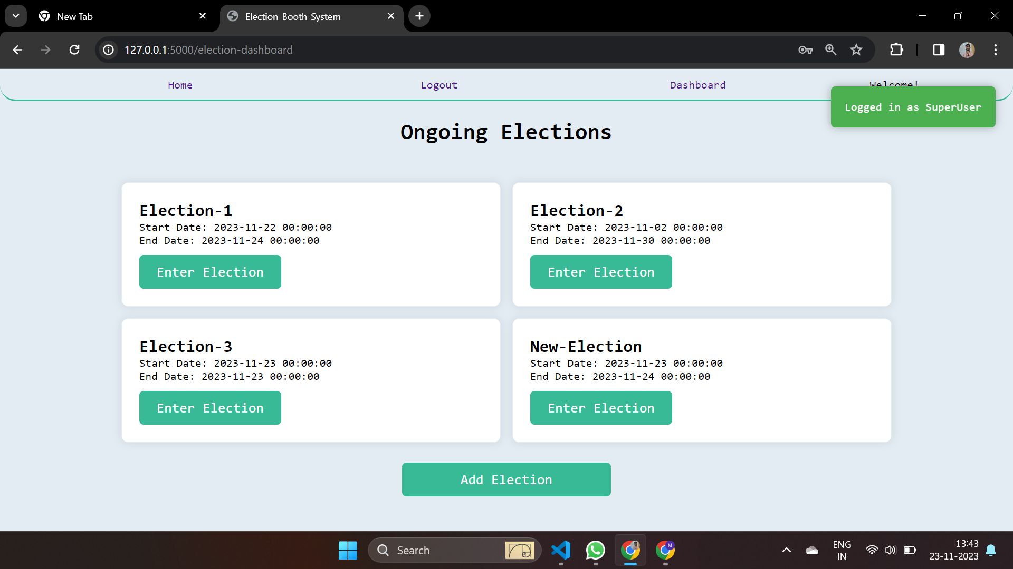

Slide 9
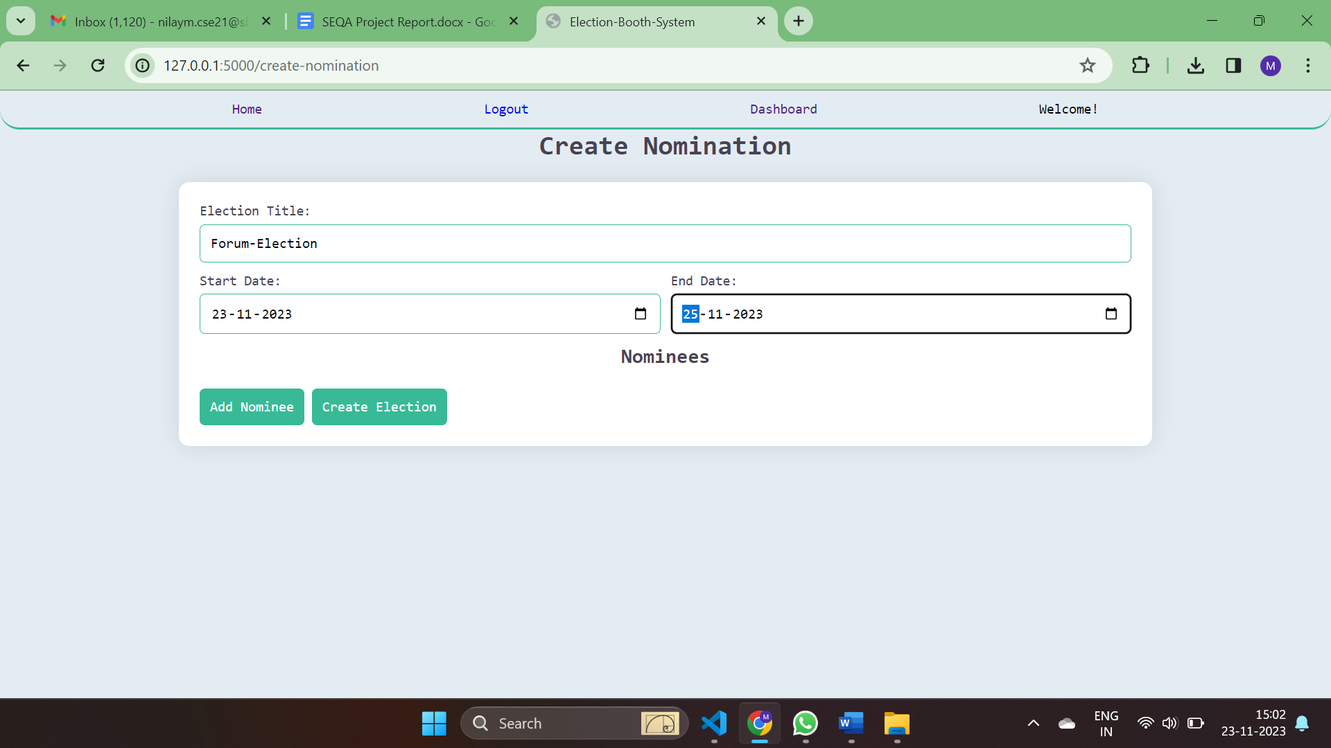

Slide 10
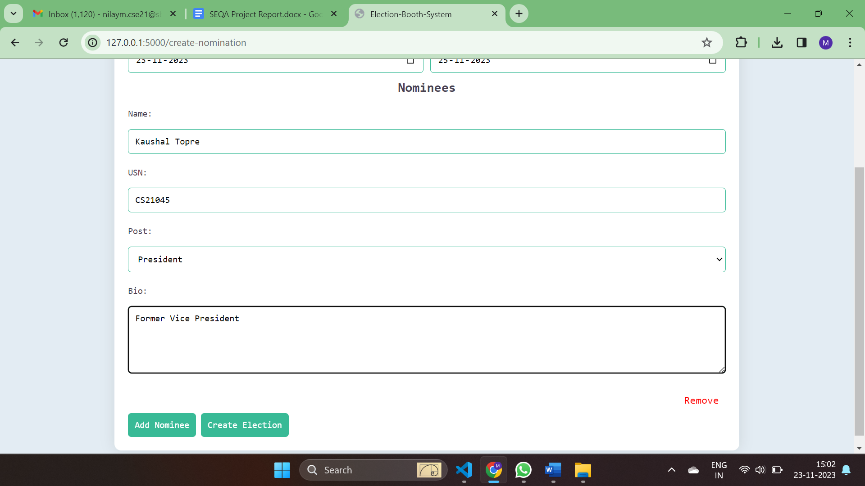

Slide 11
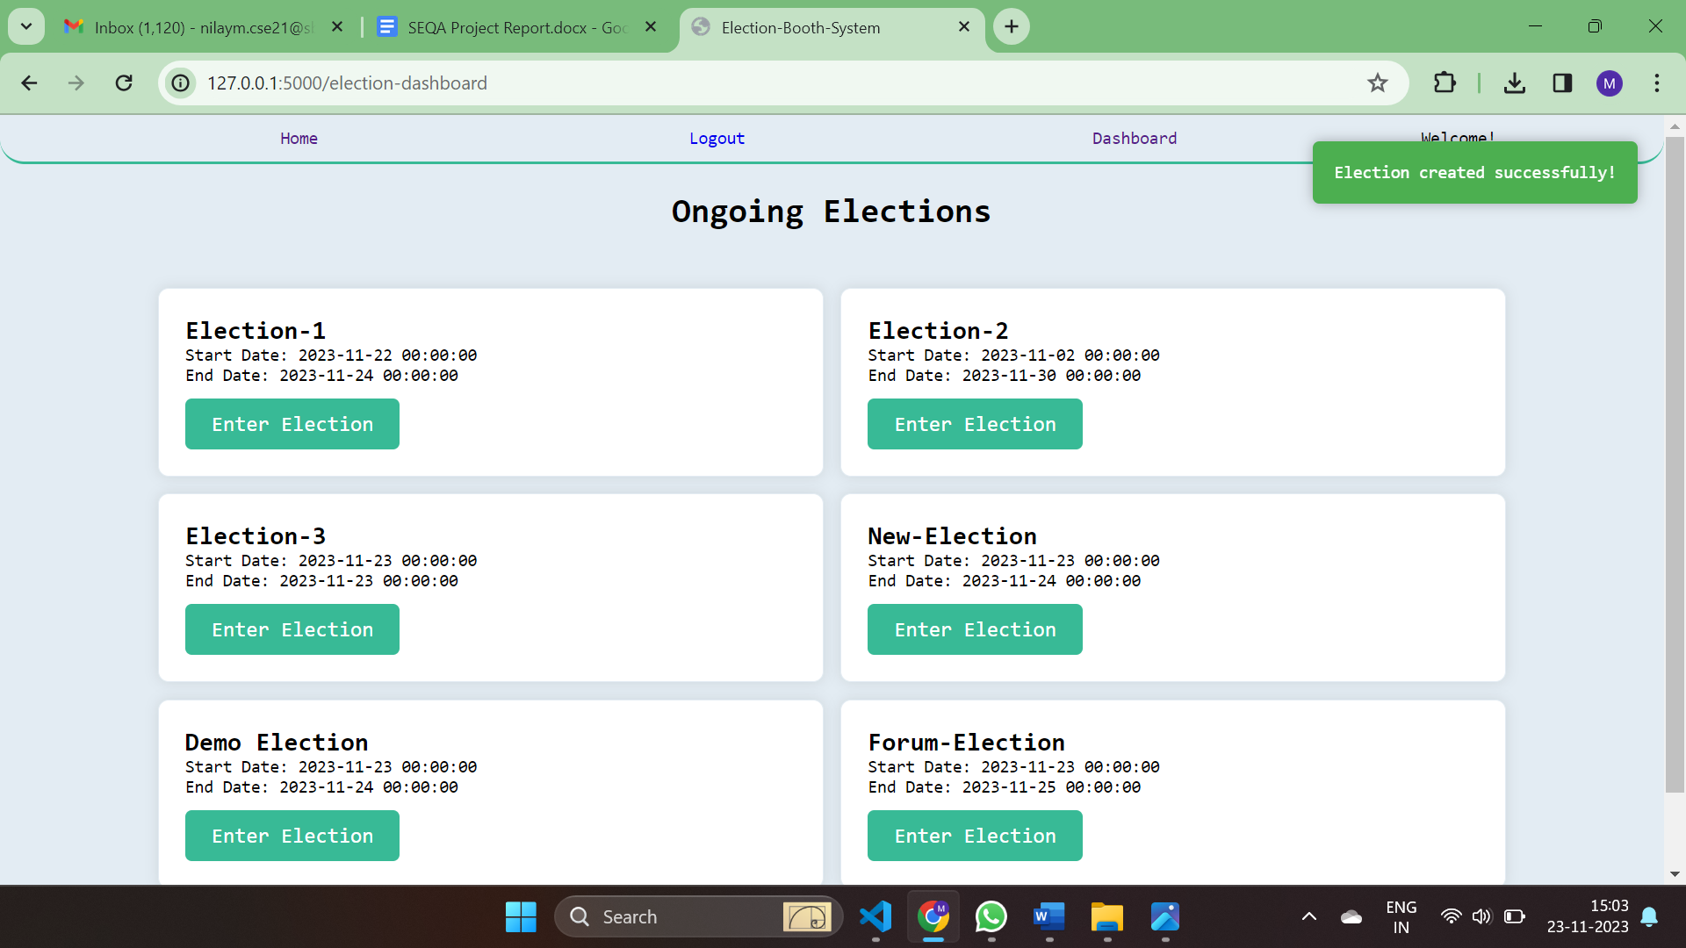

Slide 12
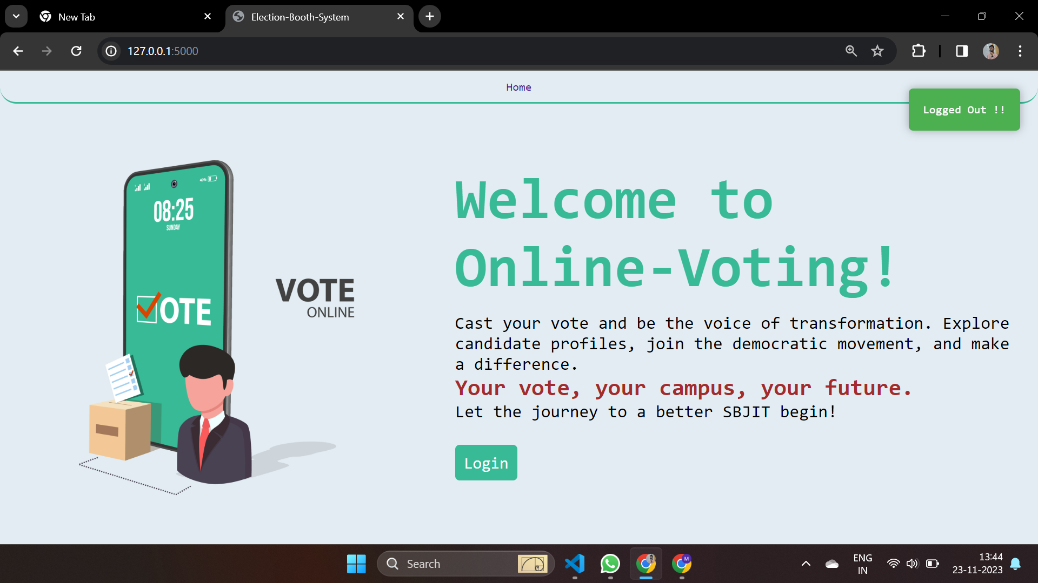

Slide 13
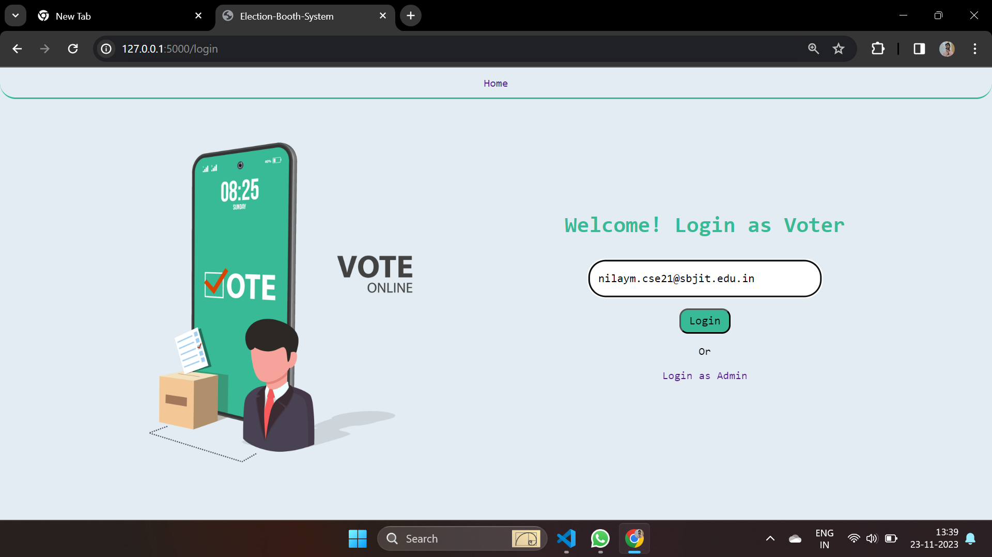

Slide 14
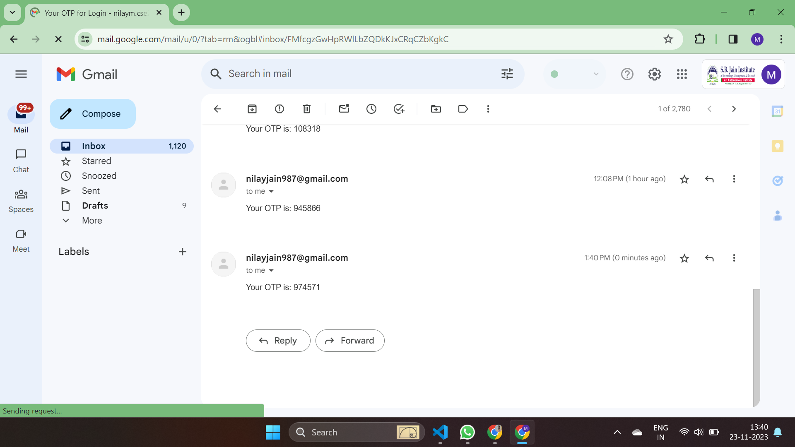

Slide 15
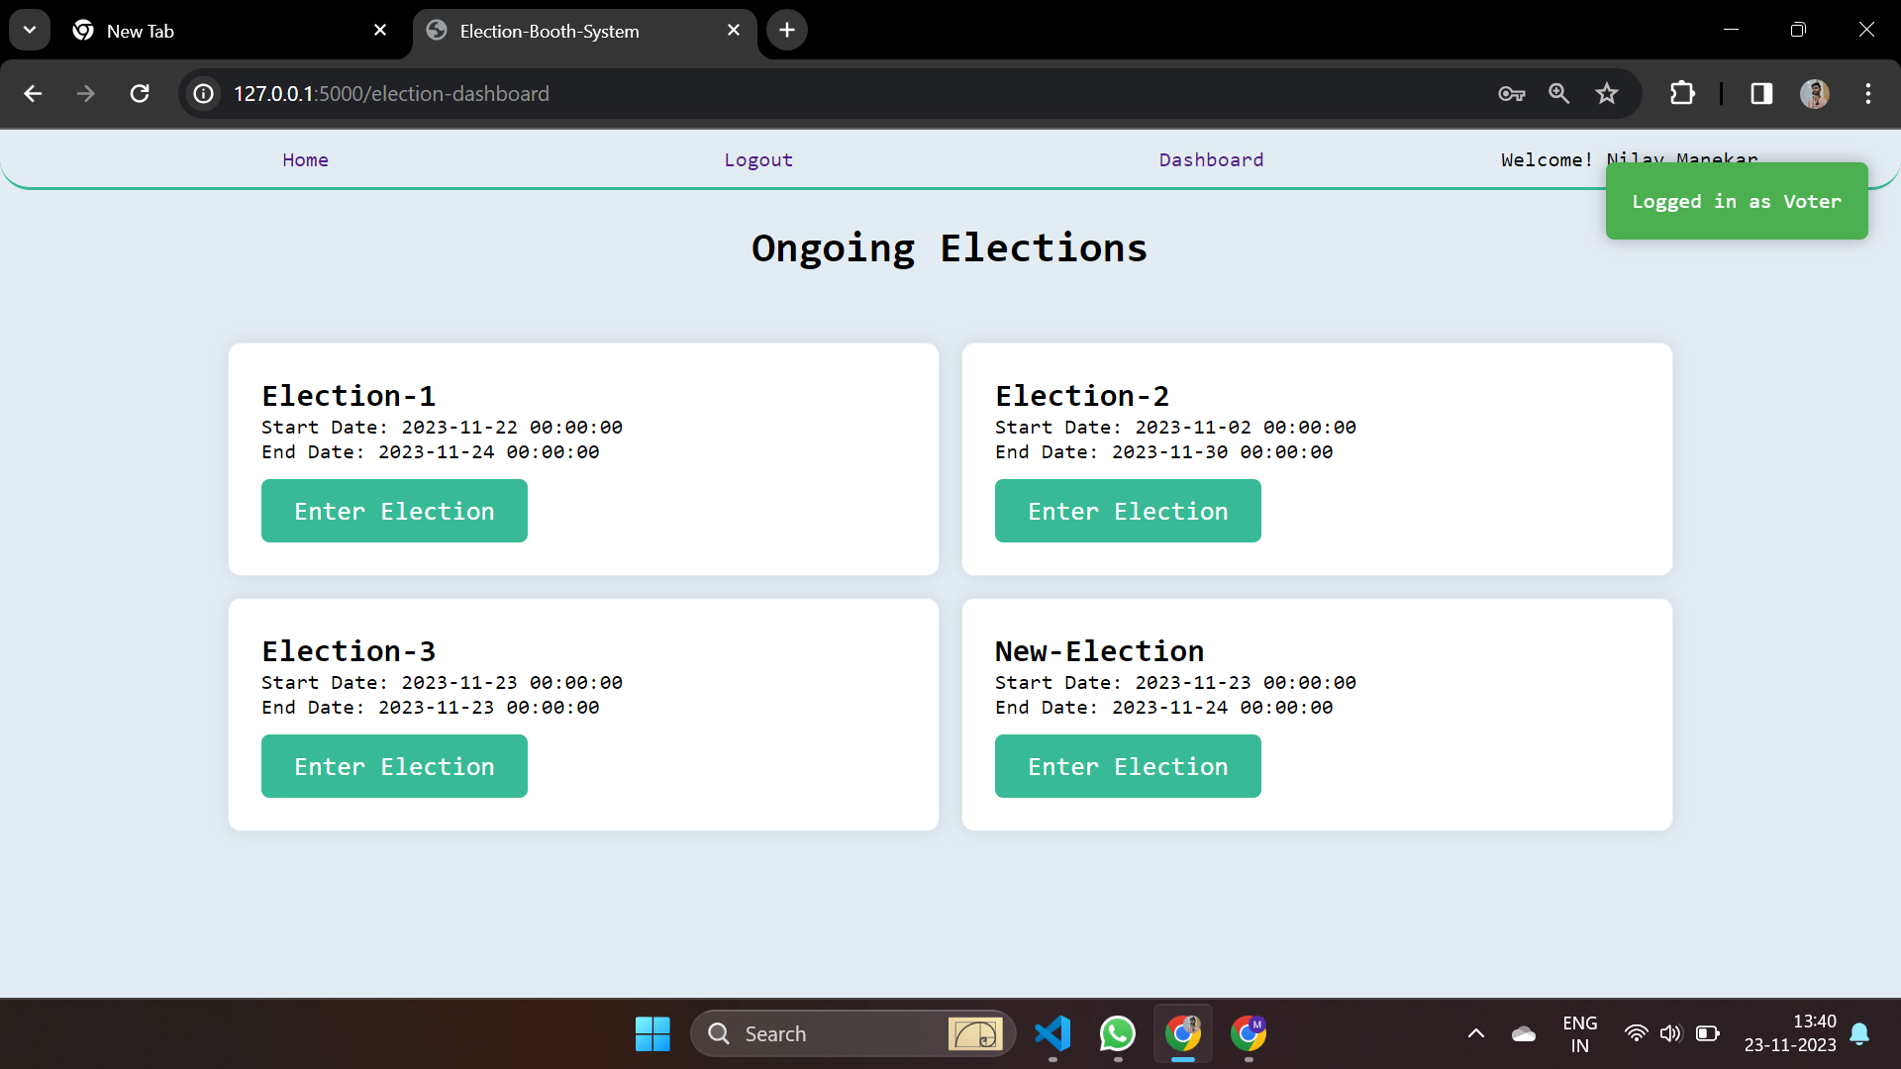

Slide 16
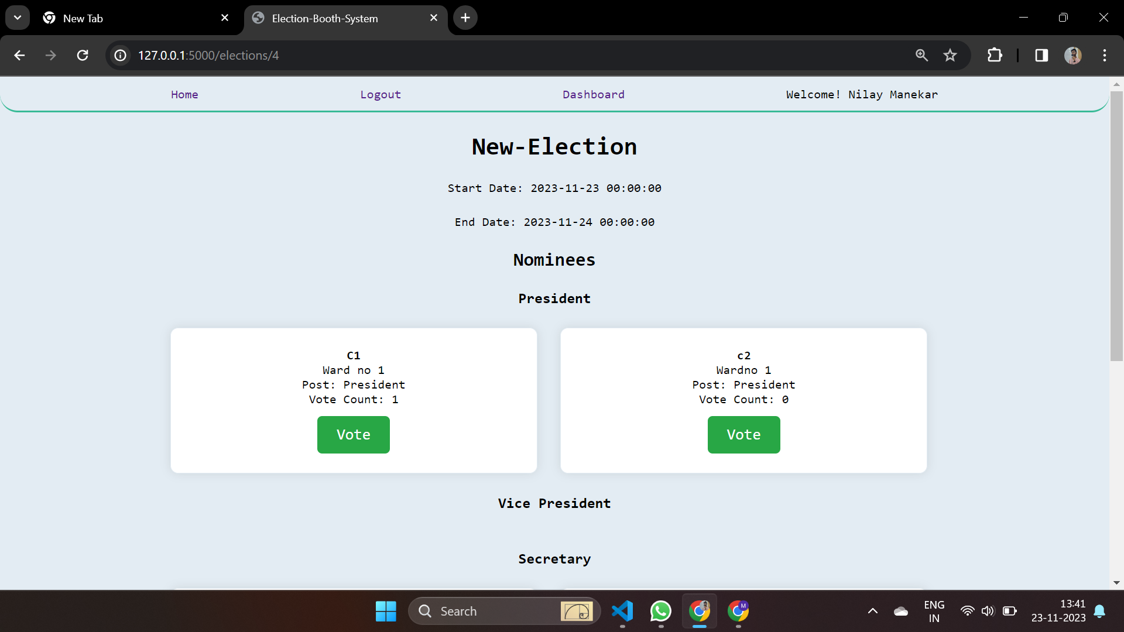

Slide 17
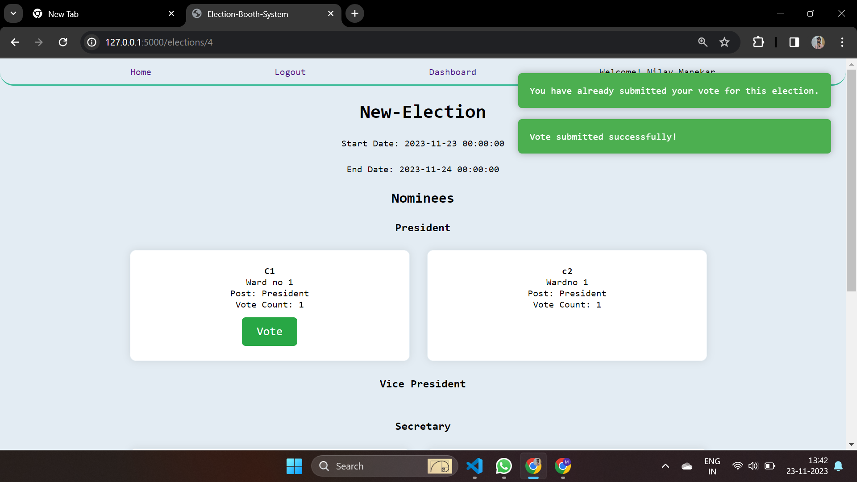

Slide 18
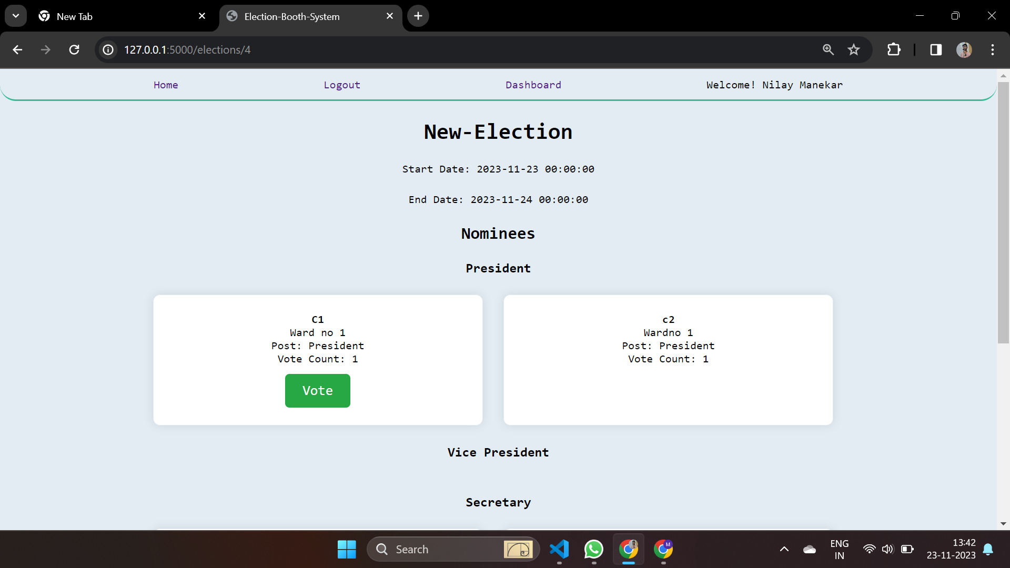

Slide 19
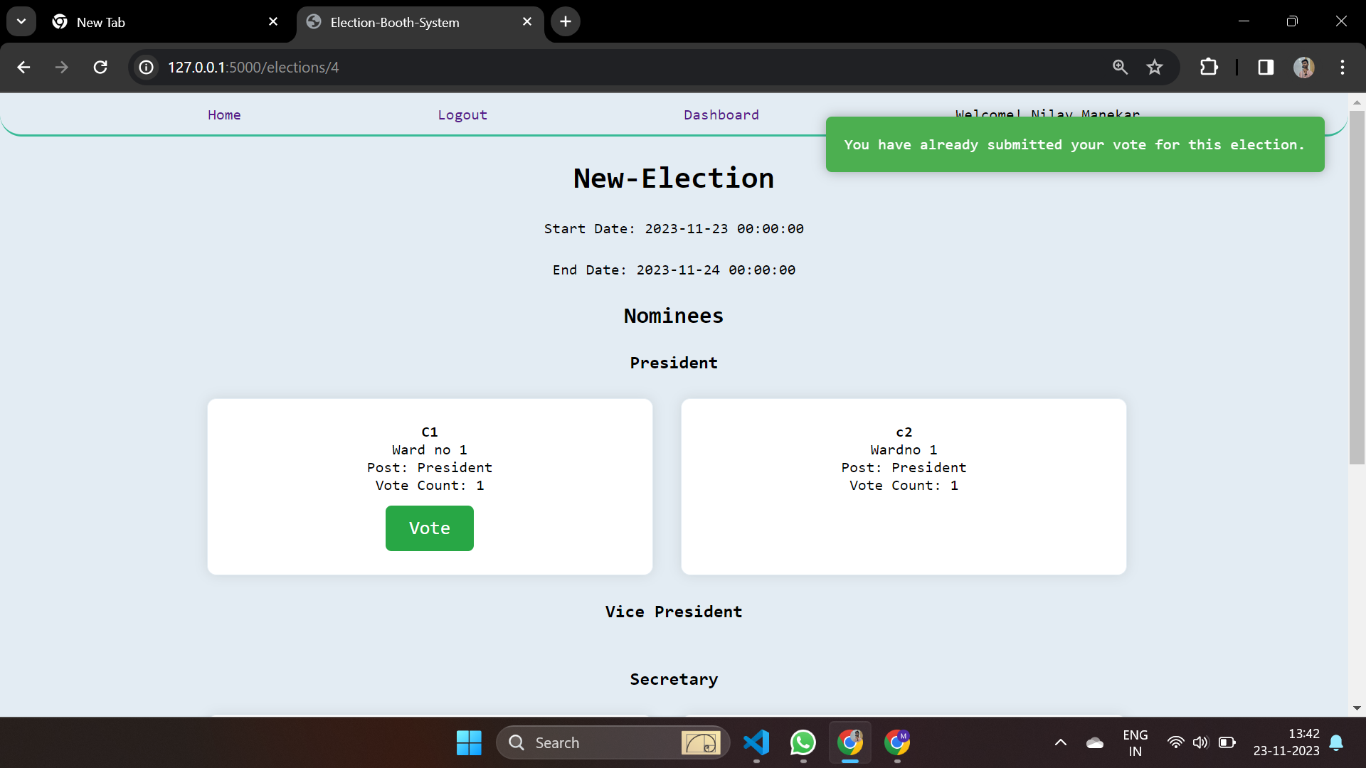

Slide 20


Slide 21
CONCLUSION
Empowering Participation and Engagement
Transformation of Electoral Process
Encourages higher turnout through a user-friendly interface, fostering community engagement.
Shifts from paper-based to a secure and efficient system, ensuring fairness and accessibility.
z
Call to Action
Trust and Transparency
Stands for innovation and inclusivity, urges continued backing for democratic enhancement within the college.
Focuses on real-time results and secure authentication to build trust among stakeholders.

